Slide 1
GATE Mímir and cloud services
Multi-paradigm indexing and search tool
Pay-as-you-go large-scale annotation

Slide 2
GATE Mímir
GATE Mímir is an indexing system for GATE documents.
Mímir can index:
  Text: the original document content is indexed (based on Token annotations)
  Annotations: annotations and features
  Semantics: annotations can be linked to external ontologies which can be used at search time
Mímir queries allow for any combination of these

Slide 3
Why Mímir?
Standard search covers the text.
GATE documents also have annotations, which give access to the document's:
  Structure (sections, titles, etc.)
  Linguistic features (nouns, verbs, etc.)
  Semantics
  Etc.
Examples: http://demos.gate.ac.uk/mimir
  BBC News demo

Slide 4
Mímir query language
Simplest queries are free text
  text
  “quoted string”
Searching against the document text

Slide 5
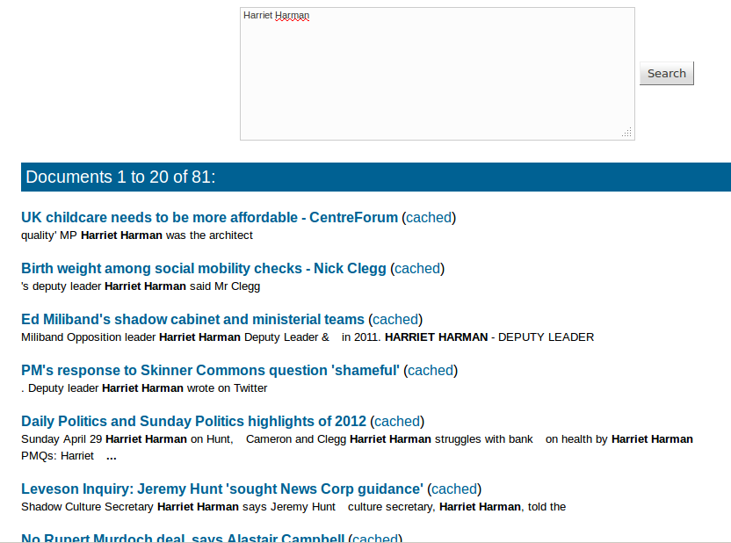
Plain text queries

Slide 6
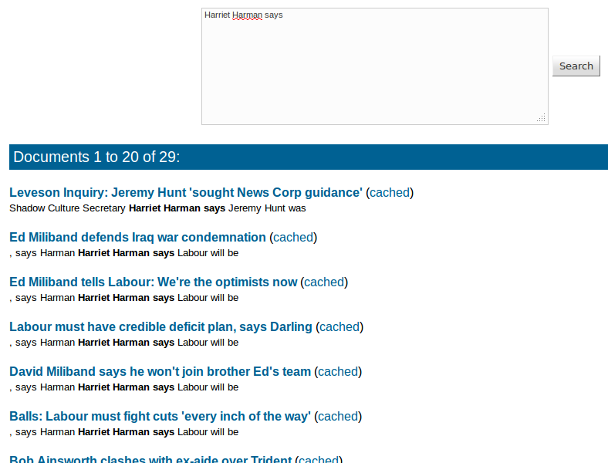
Plain text queries

Slide 7
Token features
Free text queries are actually searching the string features of the GATE Token annotations
Can also search other token features, e.g. root (morphology) or category (POS)

Slide 8
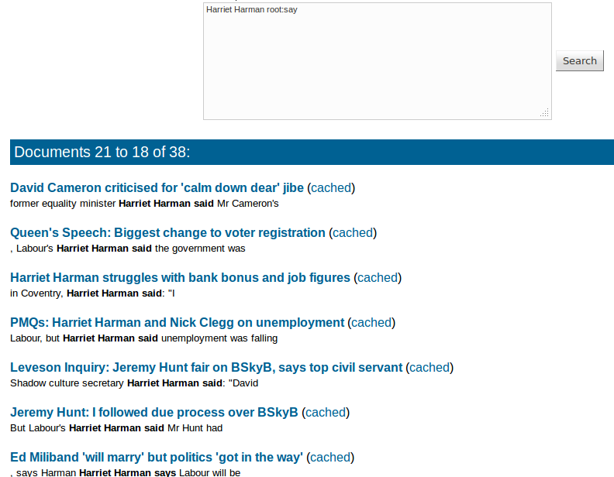
Morphology

Slide 9
Gaps
Default combinator is sequence – terms must be adjacent
  Different from typical search engines
Can allow gaps with [n..m]
Arbitrary gap with AND
  x AND y finds the shortest span that covers both

Slide 10
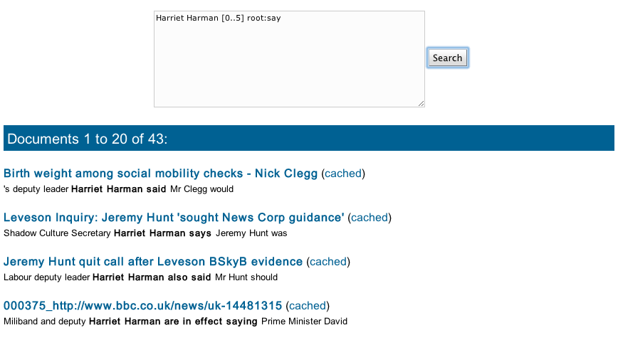
Gaps

Slide 11
Annotations
So far nothing a standard search engine couldn’t do…
But Mímir also indexes annotations
Syntax:
  {AnnotationType feat1=val1 feat2=val2}
  Feature comparisons can be =, <, <=, >=, >
  UI offers pop-up with available types/features
Let’s generalise – any person, not just Harriet

Slide 12
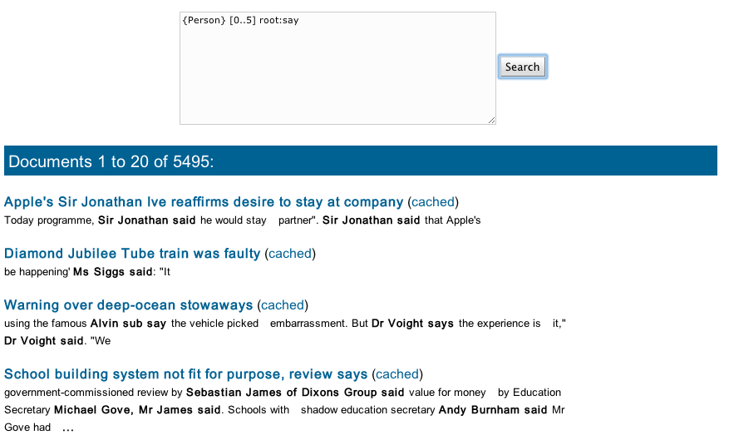
Annotations

Slide 13
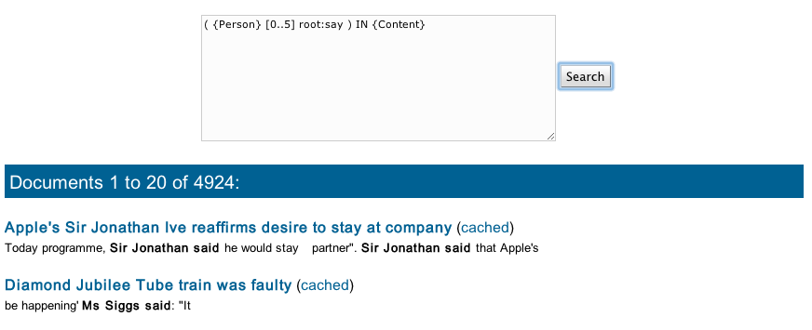
Other operators
Containment (use parentheses to group)
  Query1 IN Query2
  Query1 OVER Query2

Slide 14
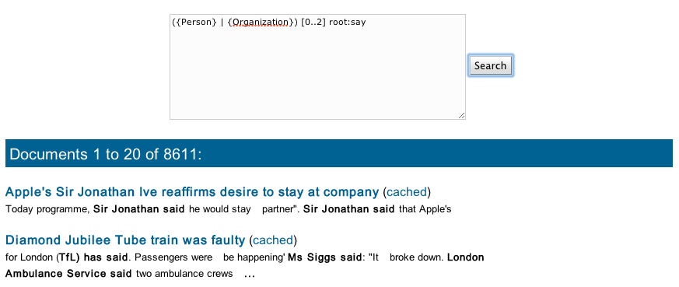
Other operators
Alternative
  Query1 OR Query2
  Query1 | Query2

Slide 15
Other operators
Set difference
  Query1 MINUS Query2
  Returns all spans that match Query1 but are not also matches of Query2
  E.g. sentences that don’t mention a location
  {Sentence} MINUS
  ( {Sentence} OVER {Location} )

Slide 16
Try it!
http://demos.gate.ac.uk/mimir
  BBC News demo
Find:
  Document titles
  Date expressions
  Amounts of money being paid
  Amounts of money being received
Hint: if you get too much noise, try
  restricting to matches within a sentence
  using IN {Content} to ignore boilerplate

Slide 17
Semantics
Annotations may be linked to a knowledge base, e.g. DBpedia (http://dbpedia.org)
Annotation refers to an instance
  http://dbpedia.org/resource/Harriet_Harman
KB knows that this instance belongs to the class of politicians (and people, …)
  http://dbpedia.org/ontology/Politician
SPARQL query language can retrieve instances that match constraints

Slide 18
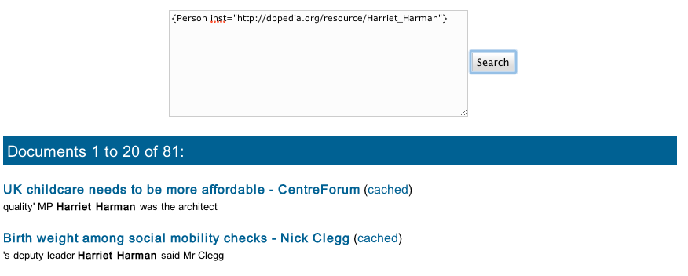
Semantics
In news demo, Person, Location and Organization have class and inst features

Slide 19
Semantic search
Can use SPARQL to query the KB at search time
E.g. to find all politicians
{Person sparql=”
SELECT DISTINCT ?inst WHERE {
?inst a :Politician }"}

Slide 20
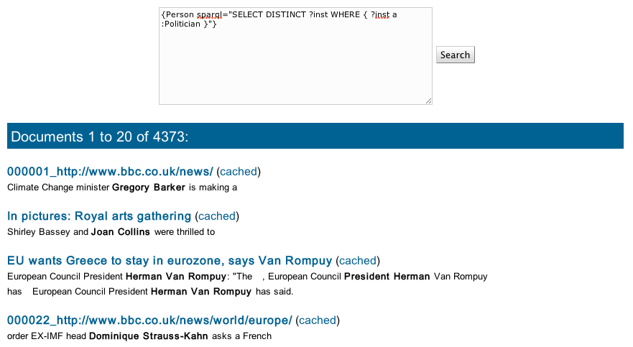
Semantic search

Slide 21
Custom UI
Not the sort of query you want to construct by hand…
Mímir provides an XML-over-HTTP query API to allow programmatic querying
Can build custom UIs that hide the query language from users
  http://demos.gate.ac.uk/pin
  Try out the query builder, look at the underlying query

Slide 22
Building an index - you need:
Some annotated GATE documents
A description of which annotations and features you want to index
  “Index template”
  Only the features you specify in the template will be available for searching
A running instance of the Mímir webapp
  You can download and build your own (requires Grails)
A way to push the documents to the server

Slide 23
Pushing documents
GATE PR
  “Mímir indexing PR” available as part of the Mímir source distribution
GCP – the “GATE Cloud Parallelizer”
  Tool to deploy a saved GATE application multi-threaded on your own machine
  Includes various “output handlers” to save annotations to disk, or push them into Mímir
  http://gate.ac.uk/gcp
or let us do it for you…

Slide 24
GATECloud.net
A cloud based service from the GATE team
Usual cloud benefits:
  Pay-as-you-go, no upfront hardware costs
  No sysadmin work
  Web-based management tools
  Always latest version, maintained by us
Not-so-usual cloud benefits
  Based on open-source software
  Bring your own pipeline

Slide 25
Features
On demand document processing (a.k.a. Annotation Jobs)
  Parallel processing on Amazon EC2
  On-line job definition tool
  Many output formats, including Mímir
On demand servers, including Mímir
Top up your account with vouchers from the University online shop

Slide 26
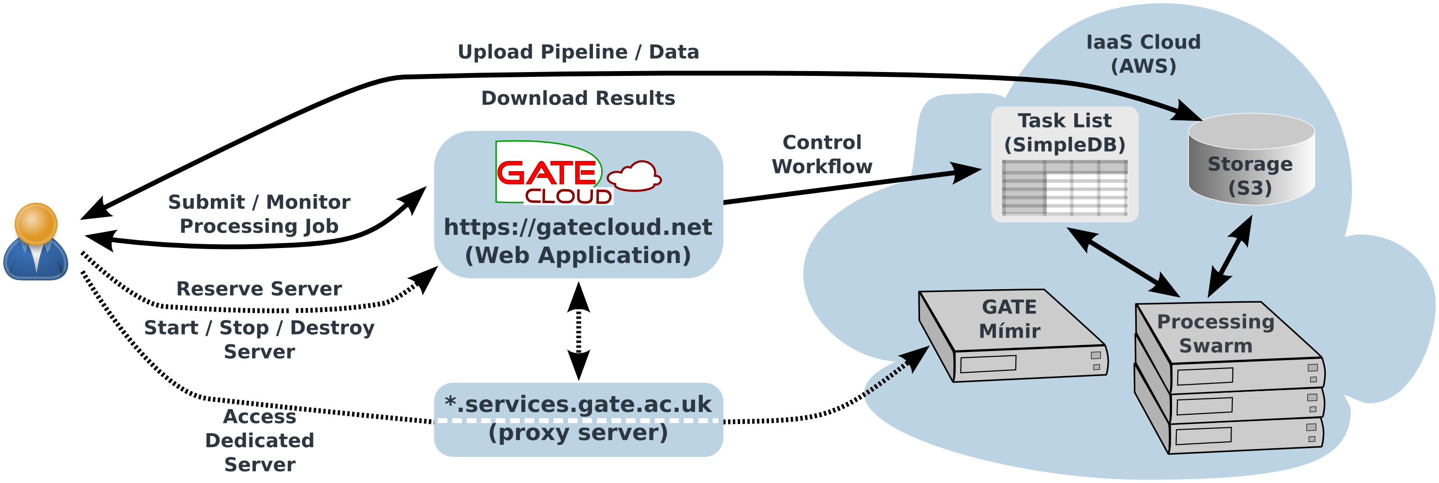
Architecture

Slide 27
Dedicated servers
Rent a dedicated Mímir server for your private use
Start and stop it as required
Pay only for the hours it is running
Data (i.e. indexes) persistent across reboots
Backup and restore facility available

Slide 28
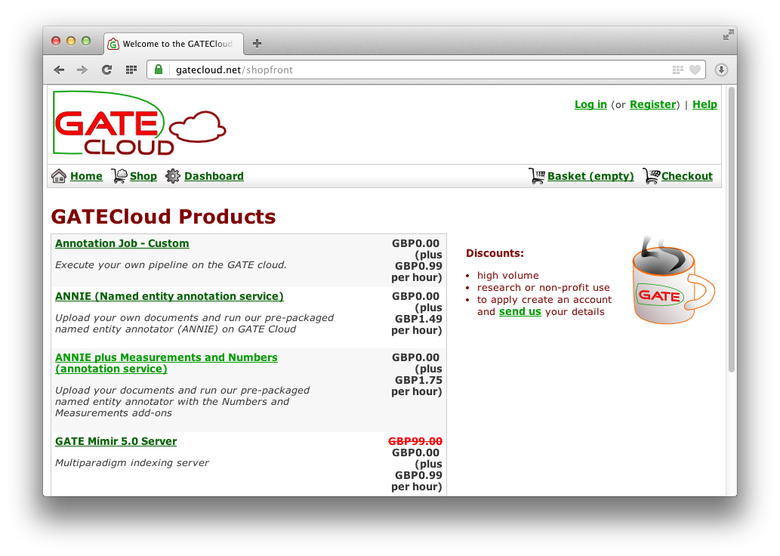
The shop

Slide 29
Reserving a server
The usual e-commerce experience
  Sign up for an account
  Buy a top-up voucher
  Add item(s) to your basket
  Checkout to complete the order
Server appears in your dashboard
Behind the scenes, creates a persistent data volume for your data

Slide 30
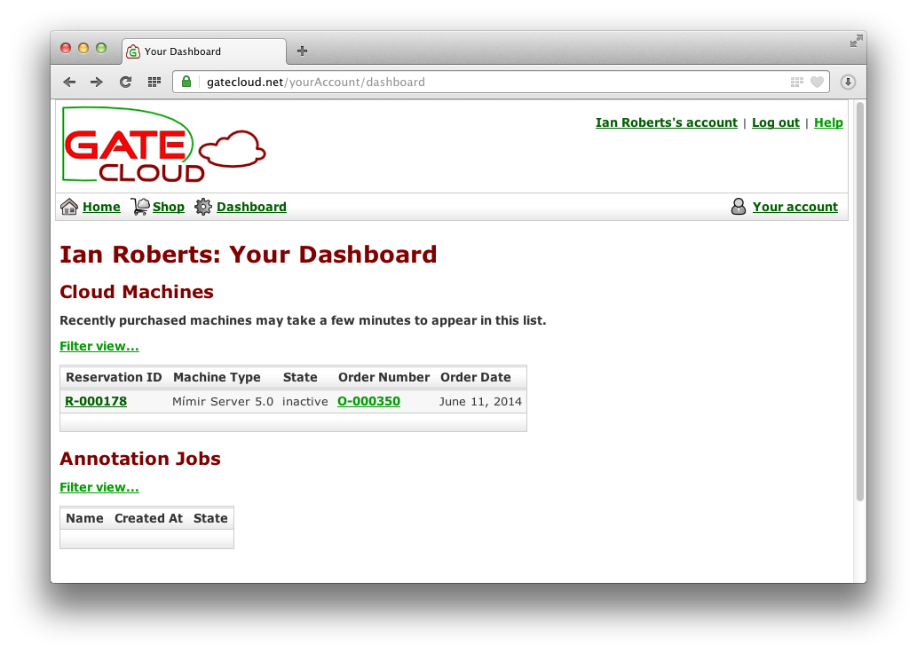
Dashboard

Slide 31
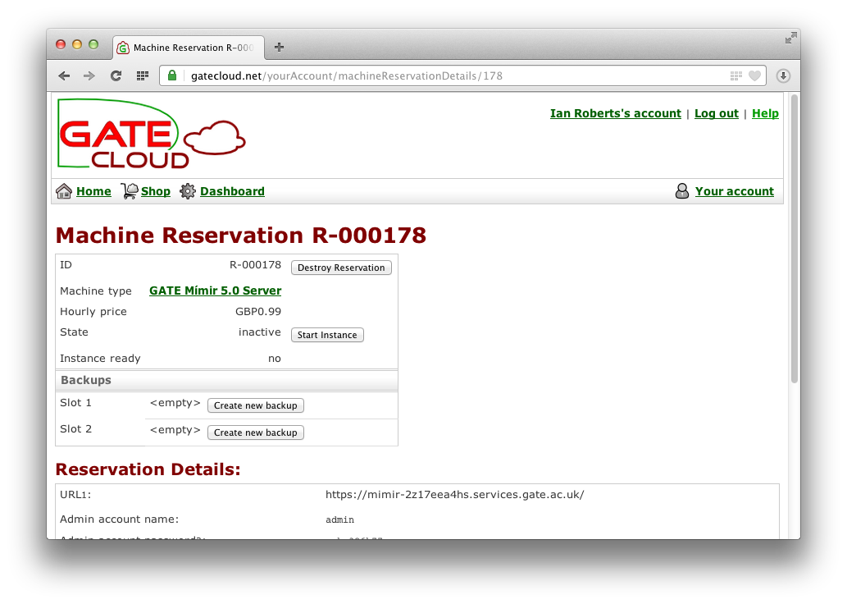
Reservation control panel

Slide 32
Controlling the server
Start and stop instance
  Startup/shutdown takes a few minutes – system will email you when server is ready
  You pay the hourly price whenever the instance is running
Backup and restore
  Save the state of your data volume so you can roll back later
Destroy reservation
  If you no longer need the server, destroy it to discard the data volume and all backups
  This cannot be undone

Slide 33
Annotation jobs
Parallel and distributed annotation of documents with a GATE application
Upload your own documents
  zip, tar, arc/warc archives
Upload your own pipeline
  “Export for GATECloud.net”
… or use a standard one
Output annotations in various formats, or send documents directly to Mímir

Slide 34
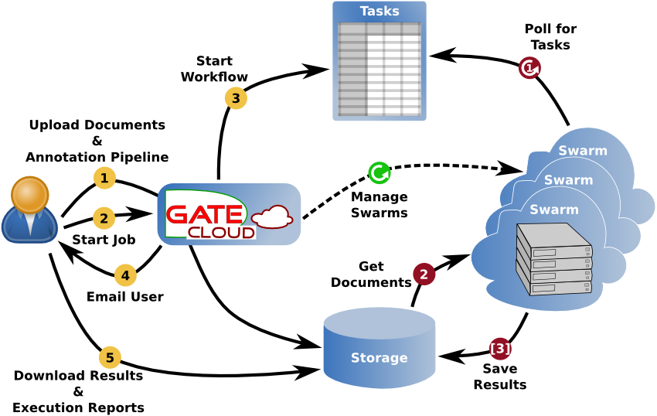
Job lifecycle

Slide 35
Execution environment
Amazon EC2
Ubuntu LTS, 64-bit
Oracle Java 7
~2GB/thread RAM on average
GCP 2.5, based on GATE Embedded 8.1

Slide 36
Reserving a job
Same process as servers
Choose the job you want from the shop
Add to basket
Checkout
Job appears in dashboard

Slide 37
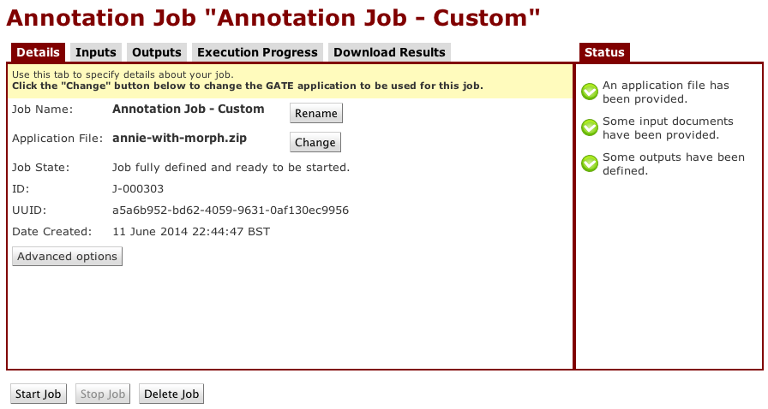
Managing a job - application

Slide 38
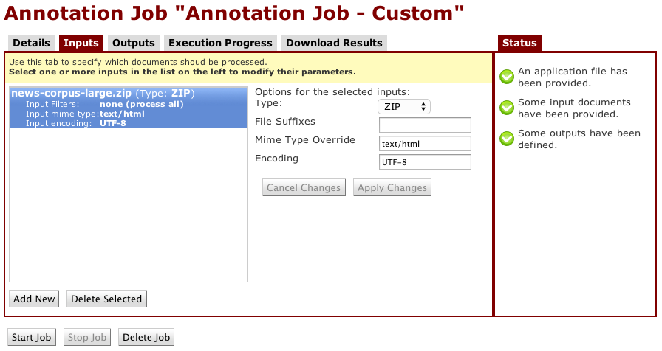
Managing a job - input

Slide 39
Outputting to Mímir
Start up the Mímir server we reserved earlier
Create an appropriate index template
Create an index

Slide 40
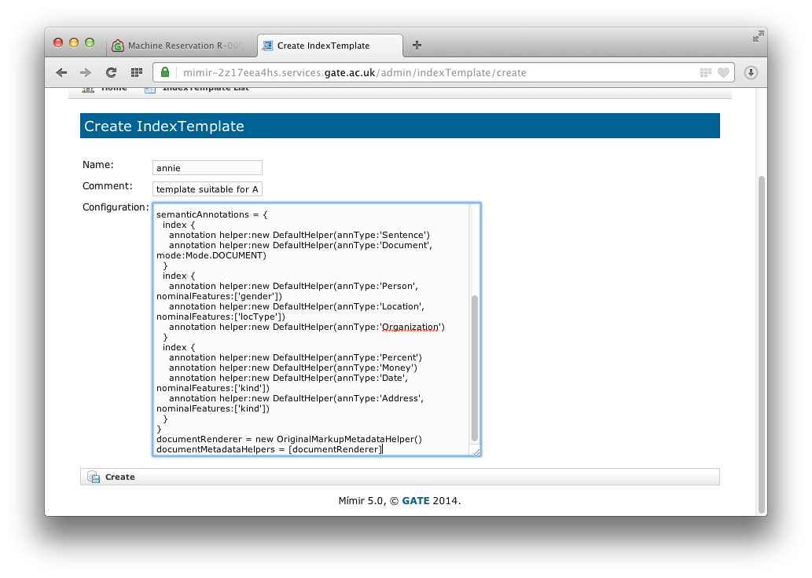
Create a template

Slide 41
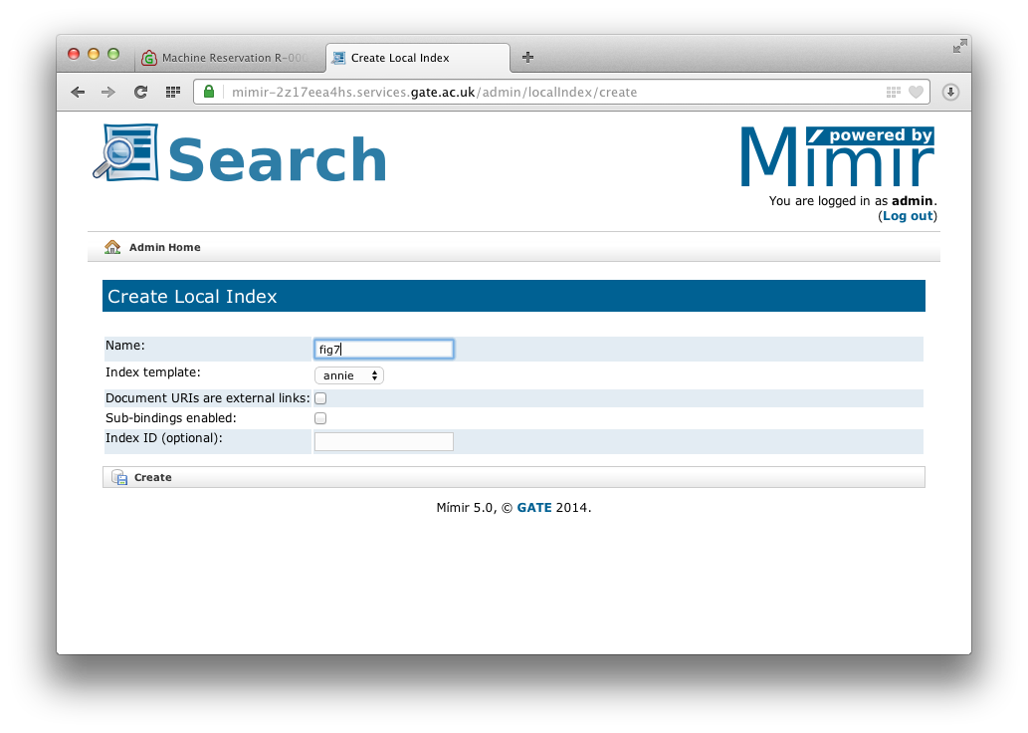
Create an index

Slide 42
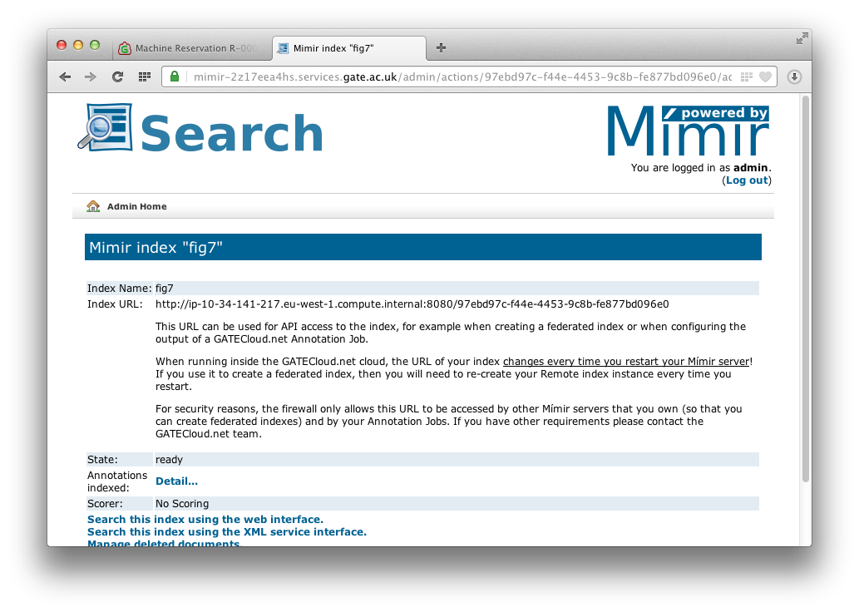
Index details – note URL

Slide 43
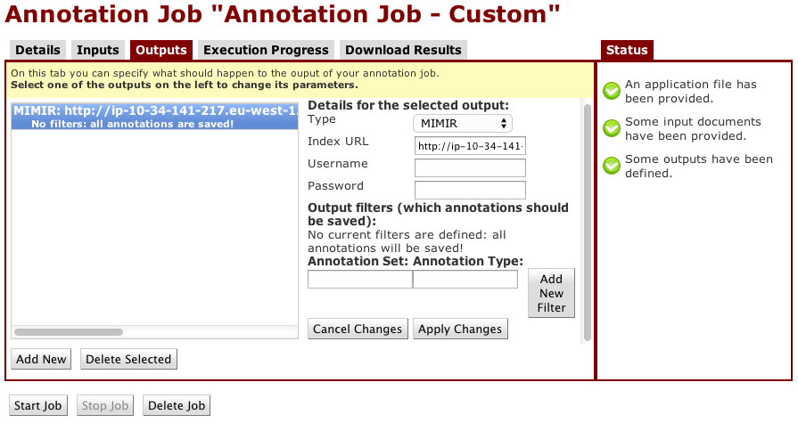
Managing a job - output

Slide 44
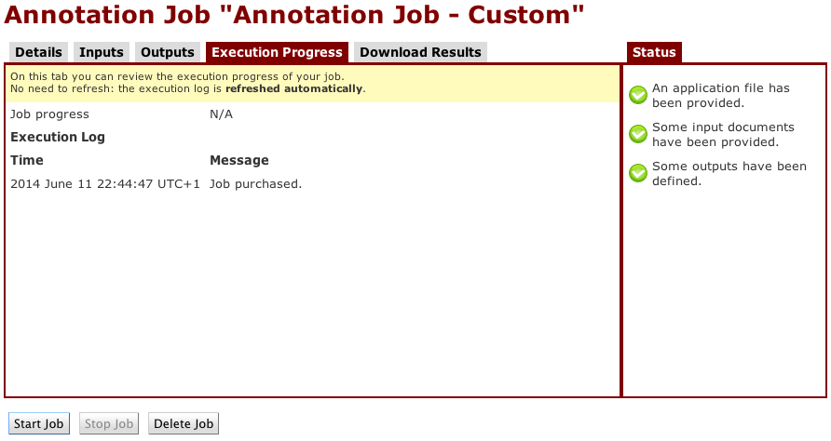
Start the job

Slide 45
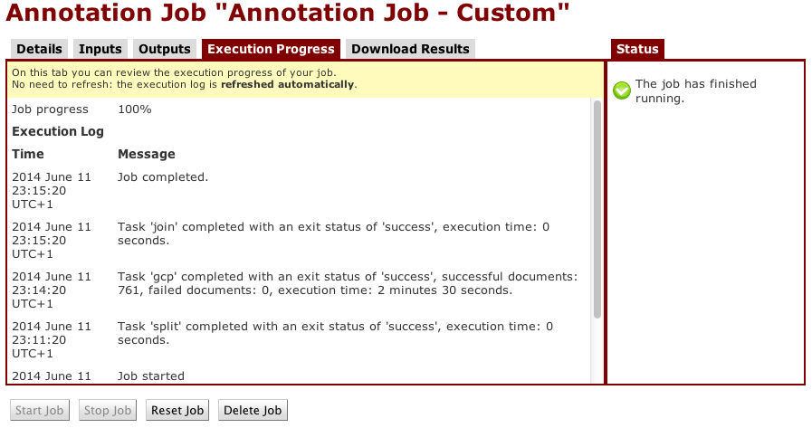
When job completes…

Slide 46
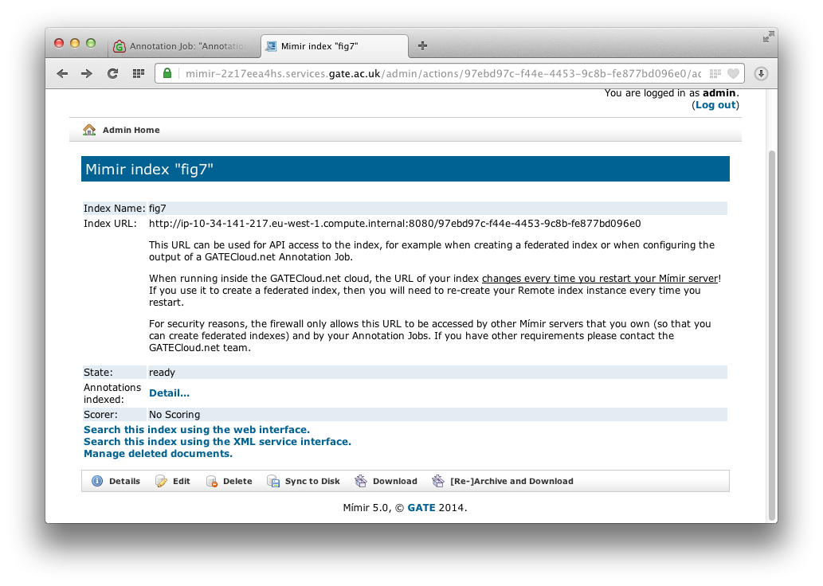
“Sync” the index

Slide 47
“Sync” the index
Mímir accumulates documents in RAM
Documents saved to disk after (by default) one hour, or when memory threshold reached
Documents become searchable once saved to disk
“Sync” button forces an immediate save, if you know no more documents due
  Can continue to send more documents, but only sync-ed ones available for search

Slide 48
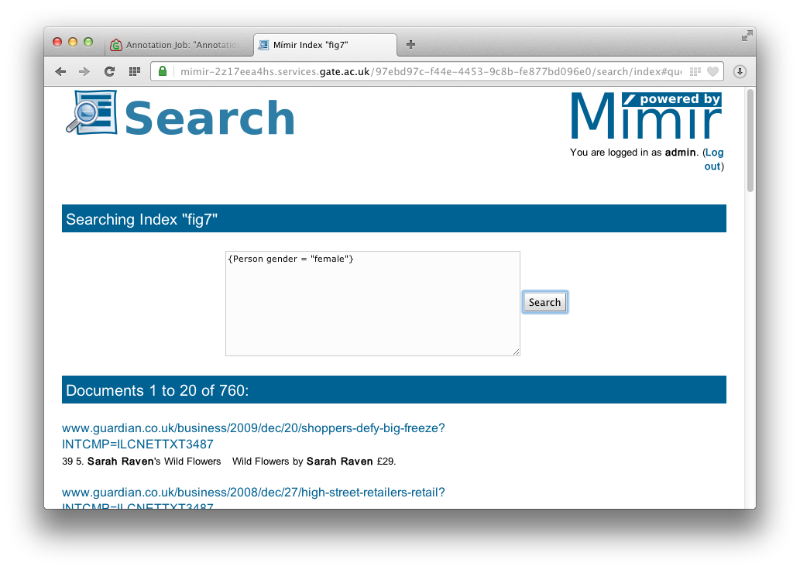
Search your new index

Slide 49
Try it!
Sign up for an account on
https://gatecloud.net
Use your voucher code
Reserve a Mímir 5.1 server
Start it up, log in
Create a new index template using the contents of index-template.groovy
Create a new local index using this template
Visit index admin page and note the URL

Slide 50
Try it!
Reserve a “custom annotation job”
Application zip file is
fastvac-application.zip
Input is pubmed-corpus-672.zip
  Mime type: text/x-pubmed, Encoding: UTF-8
Set one output to MIMIR, using the Index URL you noted above
  Make sure to not include any spaces in the index URL
Run the job, and when finished sync the index

Slide 51
Try it!
Try some searches on your new index
  {Pathogen} IN {title}
Index template points to SPARQL endpoint with the FastVac ontology
Semantic queries, e.g.
  {Animals_and_models sparql =
  "SELECT ?inst WHERE {
  ?inst a :Non-human_primate }"}
When finished, make sure you stop the Mímir server and destroy the reservation

Slide 52
Future developments
New version of GATE Cloud later this year
  Wider range of pre-packaged pipelines
  Simpler UI, plus REST API for developers
  “Test this pipeline” function to quickly try different pipelines on your text
  API to process single documents in “online” mode, with a free usage quota

Slide 53
AnnoMarket.com
New development based on GATECloud.net, adding
  A much wider range of pre-packaged pipelines
  Simplified UI, plus REST APIs for job management and processing single documents
  “Test this pipeline” function to quickly try different pipelines on your text
  Access to crawled web data

Slide 54
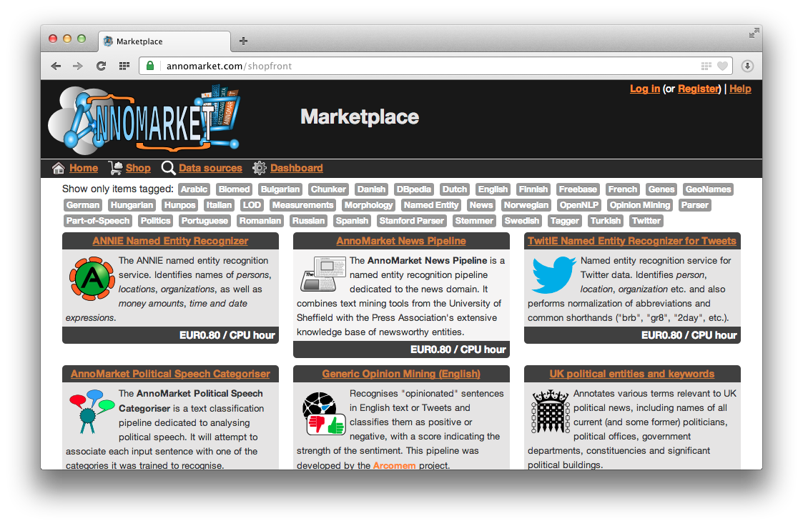
AnnoMarket.com

Slide 55
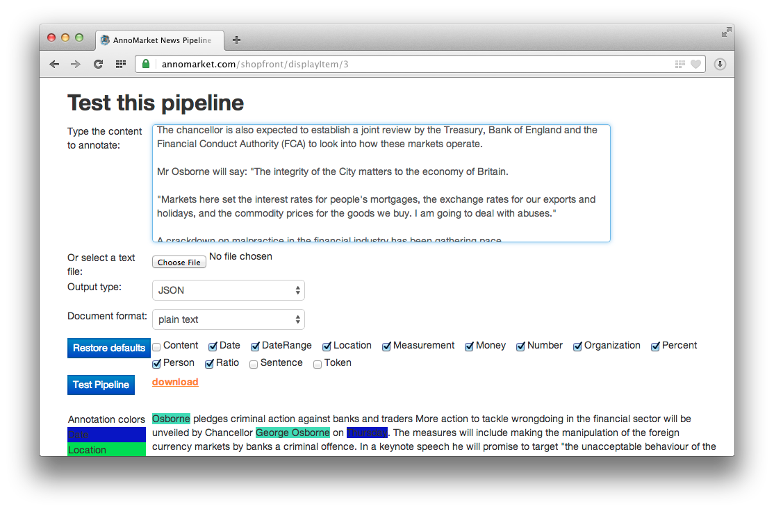
Test this pipeline

Slide 56
For developers
REST APIs for integration with other systems
Sell your own pipelines on the platform and take a cut of the proceeds
  Talk to us for more details
Vouchers available if you want to try it!

Slide 57
Questions?
More info
  https://gatecloud.net
  https://gate.ac.uk/mimir

