Slide 1
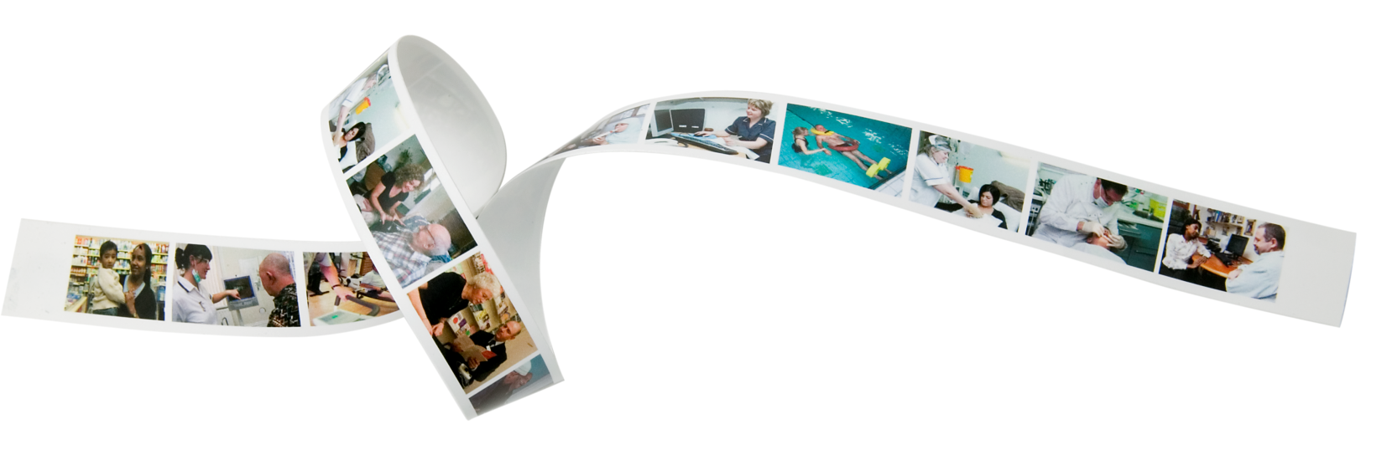
Using GATE to extract information from clinical records for research purposes
Matthew Broadbent
Clinical Informatics lead
South London and Maudsley (SLAM) NHS Foundation Trust
Specialist Biomedical Research Centre (BRC)

Slide 2
SLAM NHS Foundation Trust – the source data
Coverage: Lambeth, Southwark, . . . . . .. . . . Lewisham, Croydon
Local population: c. 1.1 million
Clinical area: specialist mental health
Active patients: c. 35000
Total inpatients: c. 1000
Total records: c. 175000
‘Active’ users: c. 5000
Electronic Health Record
The Patient Journey System

Slide 3
South London and Maudsley Biomedical Research Centre
Aim: to access clinical data from local health records for research purposes:
Value: central to academic and national government strategy
“Accessing data from electronic medical records is one of the top 3 targets for research”
Sir William Castell, Chairman Wellcome Trust

Slide 4
South London and Maudsley Biomedical Research Centre
Aim: to access clinical data from local health records for research purposes:
Value: central to academic and national government strategy
Major constraints:
security and confidentiality
structure and content of health records

Slide 5
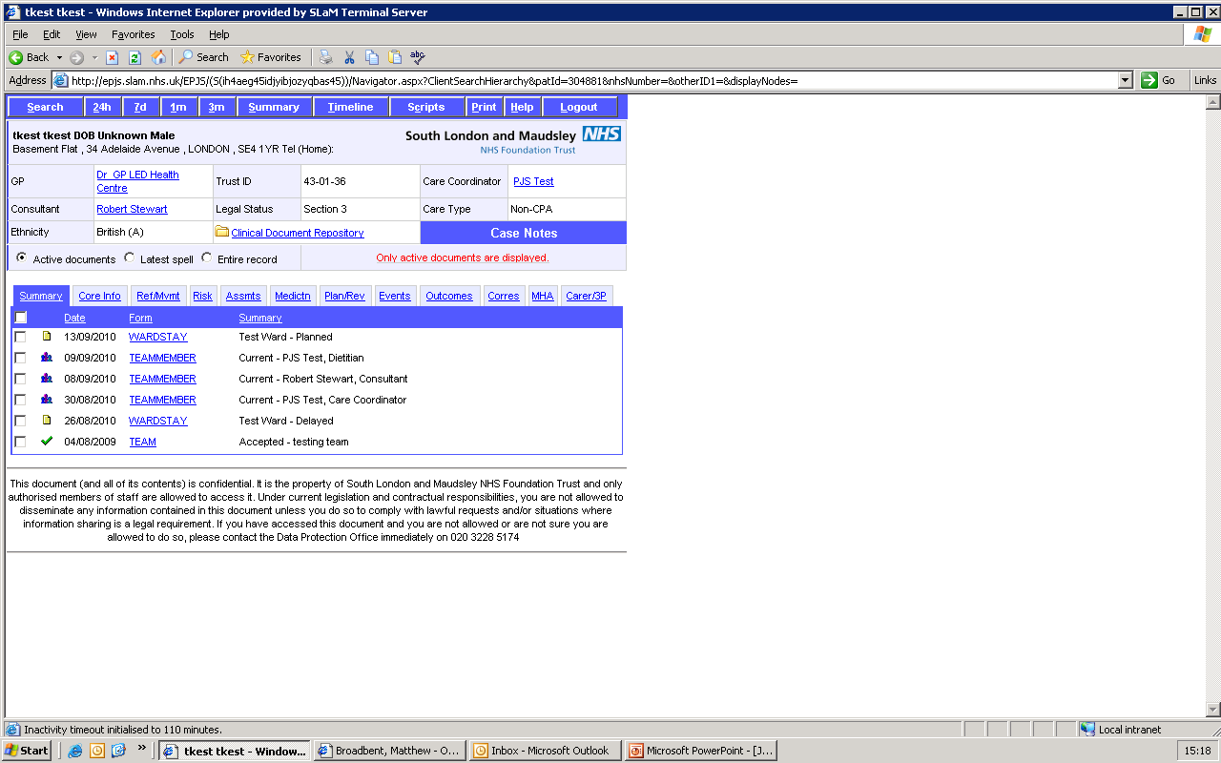

Slide 6
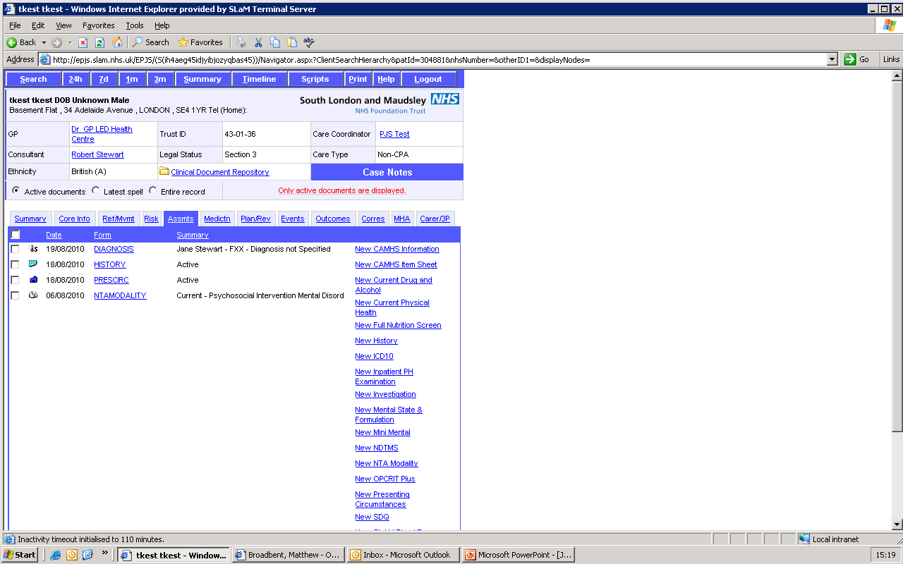

Slide 7
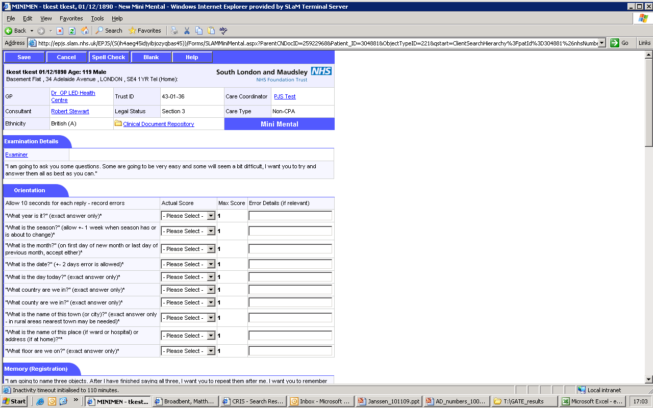

Slide 8
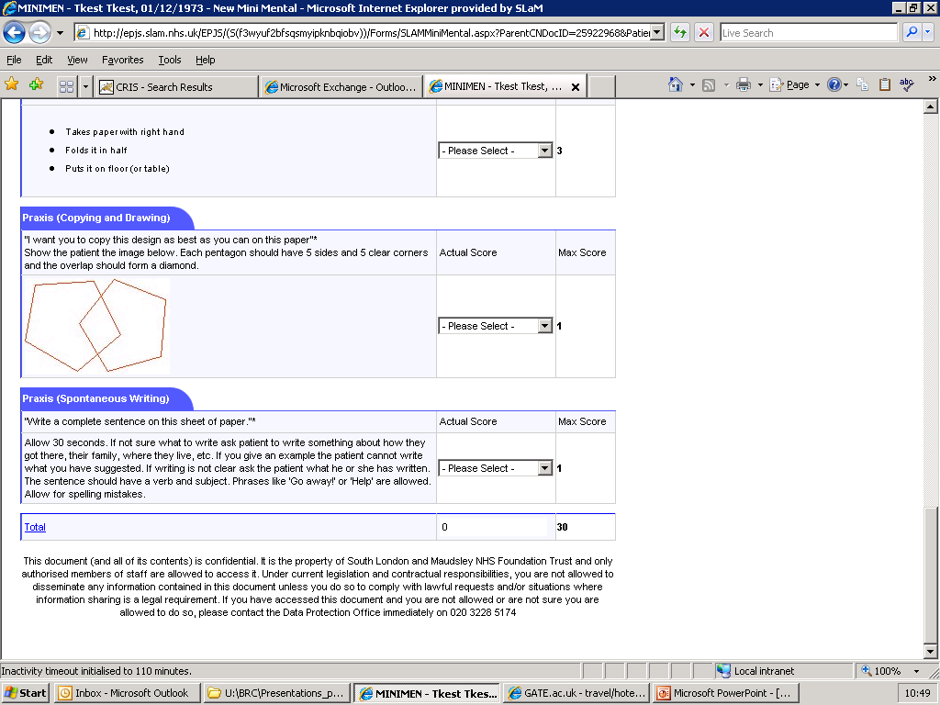

Slide 9
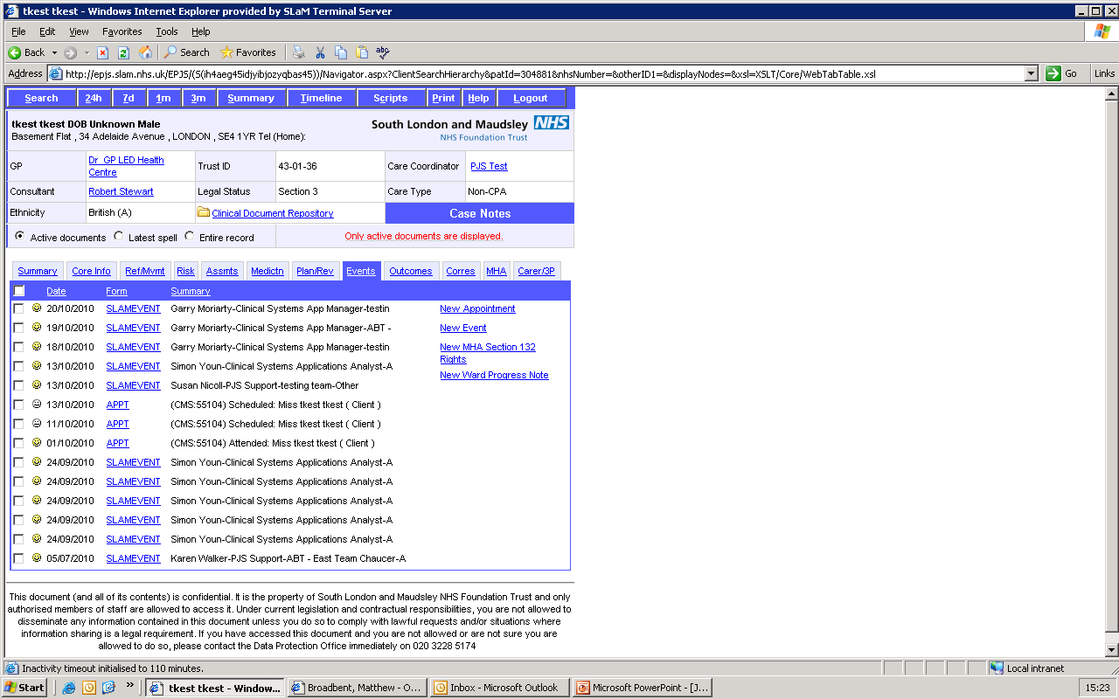

Slide 10
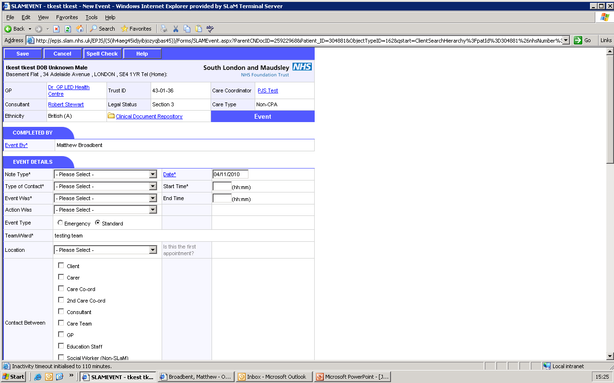

Slide 11
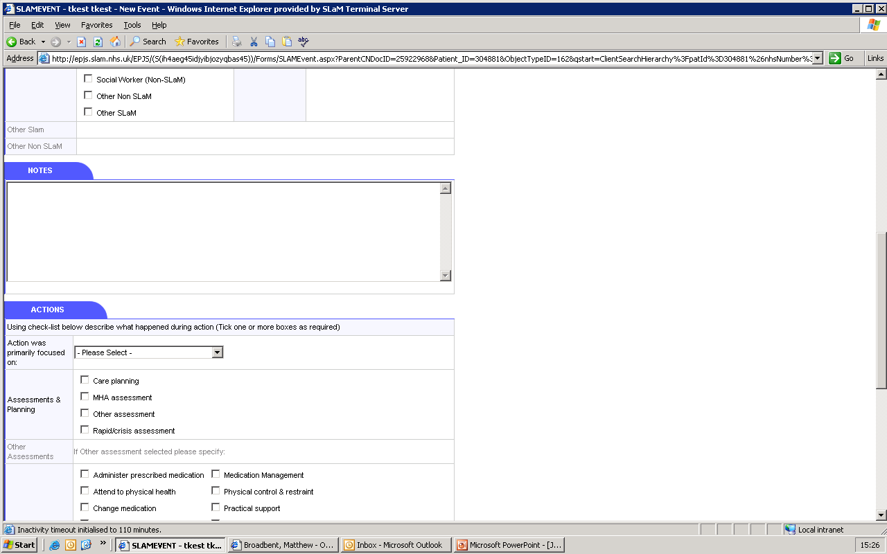

Slide 12
CRIS Architecture
PJS
CRIS application
CRIS data structure: xml.
FAST index
CRIS SQL

Slide 13
MMSE coverage
Cases Instances
MMSE (structured) 4000 5792
“MMSE” entries in free text 16585 48805

Slide 14
Using free text
Starting estimate: 80% of value (reliable, complete data) lies in free text
Design: CRIS was specifically designed to enable efficient and effective access to free text.
Issue: free text requires coding! Quantity of text is overwhelming (c.11000000. . . instances)
Solution: GATE !

Slide 15
Method to date…
BRC researchers trained in GATE, including JAPE
Applications developed in collaboration with Sheffield (Angus, Adam, Mark)
BRC
Sheffield
BRC identifies need and assesses feasibility of using GATE
Small sample (e.g. 50 instances) manually annotated
Initial application rules drafted, e.g. features and gazetteer requirements and definitions
Prototype application developed
New corpus run through the prototype and manually corrected
Application v.2 created
The application rules are collaboratively reviewed and amended throughout the process to maximise performance
These steps iterate until precision and recall have plateauxed (c. 6 iterations)

Slide 16
Method to date…
BRC
Sheffield
BRC identifies need and assesses feasibility of using GATE
Small sample (e.g. 50 instances) manually coded
Initial application rules drafted, e.g. features and gazetteer requirements and definitions
Prototype application developed
New corpus run through the prototype and manually corrected
Application v.2 created
Application v.6 created
All CRIS free text docs run through the application (c.11 million)
Results (relevant annotations/features) loaded back into source SQL database

Slide 17
GATE MMSE application
Trigger
Date
Score
Text: “MMSE done on Monday, score 24/30”

Slide 18
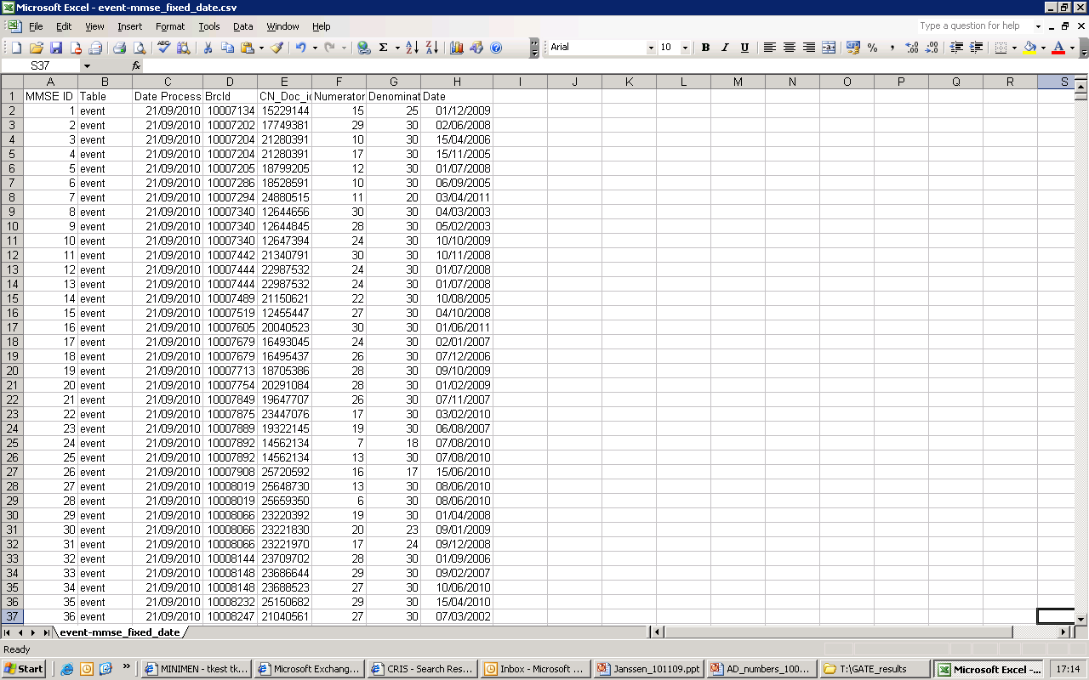

Slide 19
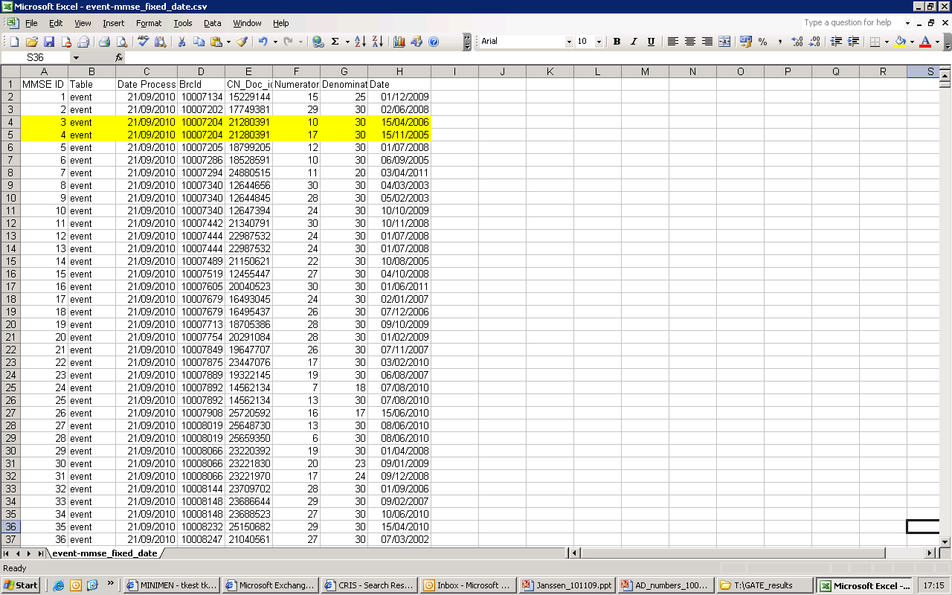

Slide 20
Using free text – GATE coding of MMSE scores / dates
Text extract from CRIS:
“MMSE scored dropped from 17/30 in November 2005 to 10/30 in April 2006”

Slide 21
MMSE coverage
Cases Instances
MMSE (structured) 4000 5792
“MMSE” entries in free text 16585 48805
MMSE ‘raw’ score/date GATE 15873 58244

Slide 22
GATE accuracy – recall and precision (unseen data)
App | Iterations | Recall | Precision | Status
Smoking status | 6 | 0.64 | 0.92 | Operational
Diagnosis | 6 | 0.84 | 0.85 | Operational
MMSE | 6 |  |  | Operational

Slide 23
Learning from experience – maximising performance
Improving performance through improved methods:
Favouring precision over recall:

Slide 24
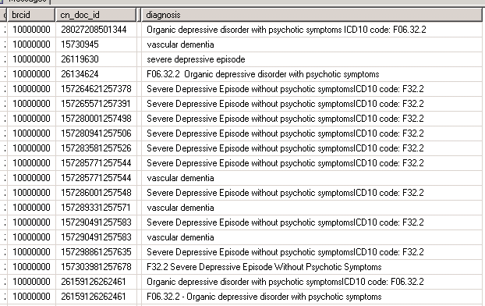
Multiple reference to diagnosis for BRCID1000000

Slide 25
Learning from experience – maximising potential
Improving performance through improved methods:
Favouring precision over recall - write rules that favour precision
Keep it simple, e.g. gazetteer list to identify patients that live alone:
“lives alone”
“lives by him/her self”
“lives on his/her own”
App | Iterations | Recall | Precision | Status
“lives alone” | 1 | 1.00 | 0.94 | Dev

Slide 26
Learning from experience – maximising potential
Improving performance through improved methods:
Better ‘rules’ – favouring precision over recall
Post processing

Slide 27
Post-processing: MMSE annotation codes applied locally
Valid
The MMSE numerator was larger than 30
The MMSE numerator was larger than the denominator
The MMSE result date is 10 years before the document's creation date
The MMSE numerator was missing
The MMSE result occurs on the same day as a previous result
Missing Date Information
The MMSE result date is more than 31 days after the CRIS record date
The MMSE result date is within 31 days of a previous result (and the. . . . . result was the same)
The MMSE result occurs on the same day as a previous result

Slide 28
MMSE coverage
Cases Instances
MMSE (structured) 4000 5792
Text instances with “MMSE” 16585 48805
MMSE ‘raw’ score/date GATE 15873 58244
MMSE valid score/date GATE 15364 34871

Slide 29
Post-processing: supportive features
Add features that support / improve post-processing
e.g. education annotation = “her father failed art A-level”
Level: GSCE
Rule: Fail
Subject: ‘her father’
Enables:
testing of recall and precision for different annotations types
selection of appropriate annotations for different analyses
context to be taken into account in post-processing e.g.
- for male patient with Alzheimer’s; DoB 1934; no other education annotation
- for female patient with depression; DoB 1964; other annotation level = degree

Slide 30
Learning from experience – maximising potential
Improving performance through improved methods:
Better ‘rules’ – favouring precision over recall
Post processing - supported by appropriate rules and features
Better development methodology

Slide 31
Methods to date…
BRC
Sheffield
BRC identifies need and assesses feasibility of using GATE
Small sample (e.g. 50 instances) manually coded
Initial application rules drafted, e.g. features and gazetteer requirements and definitions
Prototype application developed
New corpus (e.g. 50 instances) run through the prototype and manually corrected
Application v.6 created
All CRIS free text docs run through the application (c.11 million)
Results (relevant annotations/features) loaded back into source SQL database
Occasional unexpected weirdness!

Slide 32
Post-processing: MMSE annotation codes applied locally
The MMSE numerator was larger than 30
The MMSE numerator was larger than the denominator
The MMSE result date is 10 years before the document's creation date
The MMSE numerator was missing
The MMSE result occurs on the same day as a previous result
Missing Date Information
The MMSE result date is more than 31 days after the CRIS record date
The MMSE result date is within 31 days of a previous result (and the. . . . . result was the same)
The MMSE result occurs on the same day as a previous result

Slide 33
Post-processing: MMSE annotation codes applied locally
The MMSE numerator was larger than 30
The MMSE numerator was larger than the denominator
The MMSE result date is 10 years before the document's creation date
The MMSE numerator was missing
The MMSE result occurs on the same day as a previous result
Missing Date Information
The MMSE result date is more than 31 days after the CRIS record date
The MMSE result date is within 31 days of a previous result (and the. . . . . result was the same)
The MMSE result occurs on the same day as a previous result

Slide 34
Post-processing: MMSE annotation codes applied locally
The MMSE numerator was larger than 30
The MMSE numerator was larger than the denominator
The MMSE result date is 10 years before the document's creation date
The MMSE numerator was missing
The MMSE result occurs on the same day as a previous result
Missing Date Information
The MMSE result date is more than 31 days after the CRIS record date
The MMSE result date is within 31 days of a previous result (and the. . . . . result was the same)
The MMSE result occurs on the same day as a previous result

Slide 35
Methods to date…
BRC
Sheffield
BRC identifies need and assesses feasibility of using GATE
Small sample (e.g. 50 instances) manually coded
Initial application rules drafted, e.g. features and gazetteer requirements and definitions
Prototype application developed
All CRIS free text docs run through the application (c.11 million)
Application v.6 created
Results (relevant annotations/features) loaded back into source SQL database

Slide 36
Learning from experience – maximising potential
Improving performance through improved methods:
Better ‘rules’ – favouring precision over recall
Post processing – include rules and features to support
Better development methodology
Play to GATE’s strengths (don’t ask GATE to do what you can do better yourself)
Know your data!

Slide 37
GATE accuracy – recall and precision (unseen data)
App | Iterations | Recall | Precision | Status
MMSE | 6 |  |  | Operational
Diagnosis | 6 | 0.84 | 0.85 | Operational
Smoking status | 6 | 0.64 | 0.92 | Operational

Slide 38
GATE accuracy – recall and precision (unseen data)
App | Iterations | Recall | Precision | Status
MMSE | 6 |  |  | Operational
Diagnosis | 6 | 0.84 | 0.85 | Operational
Smoking status | 6 | 0.64 | 0.92 | Operational
Medication | 4 | 0.71 | 0.82 | Development
Education level | 3 | 0.79 | 0.86 | Development
Left school age | 3 | 0.87 | 0.99 | Development
SSD Interventions | 3 | 0.96 | 0.96 | Development
Lives alone | 1 | 1.00 | 0.94 | Development
App | Iterations | Recall | Precision | Status
MMSE | 6 |  |  | Operational
Diagnosis | 6 | 0.84 | 0.85 | Operational
Smoking status | 6 | 0.64 | 0.92 | Operational

Slide 39
Using GATE data in real research
How good is ‘good enough’?

Slide 40
Using GATE data in real research
1. Investigating relationships between cancer treatment and mental health disorders
Pilot for Department of Health Research Capability Programme, linking data from different clinical sources (CRIS and Thames Cancer Registry)
Using data from GATE applications:
MMSE
Smoking
4609 ‘smoking status’ features for 1039 patients, from a total linked data set of c.3500 cases.
Diagnosis

Slide 41
Using GATE data in real research
2. Investigating cost of care related to cognitive function in people with Alzheimers
Collaboration with pre-competitive pharma consortium
Using data from GATE applications:
MMSE
Diagnosis
803 new cases of Alzheimer’s identified from a combined total of 4900 cases
Education
Lives alone
Social care
Care home
Medication

