Slide 1

Information Extraction with
Linked Life Data
www.linkedlifedata.com

Slide 2
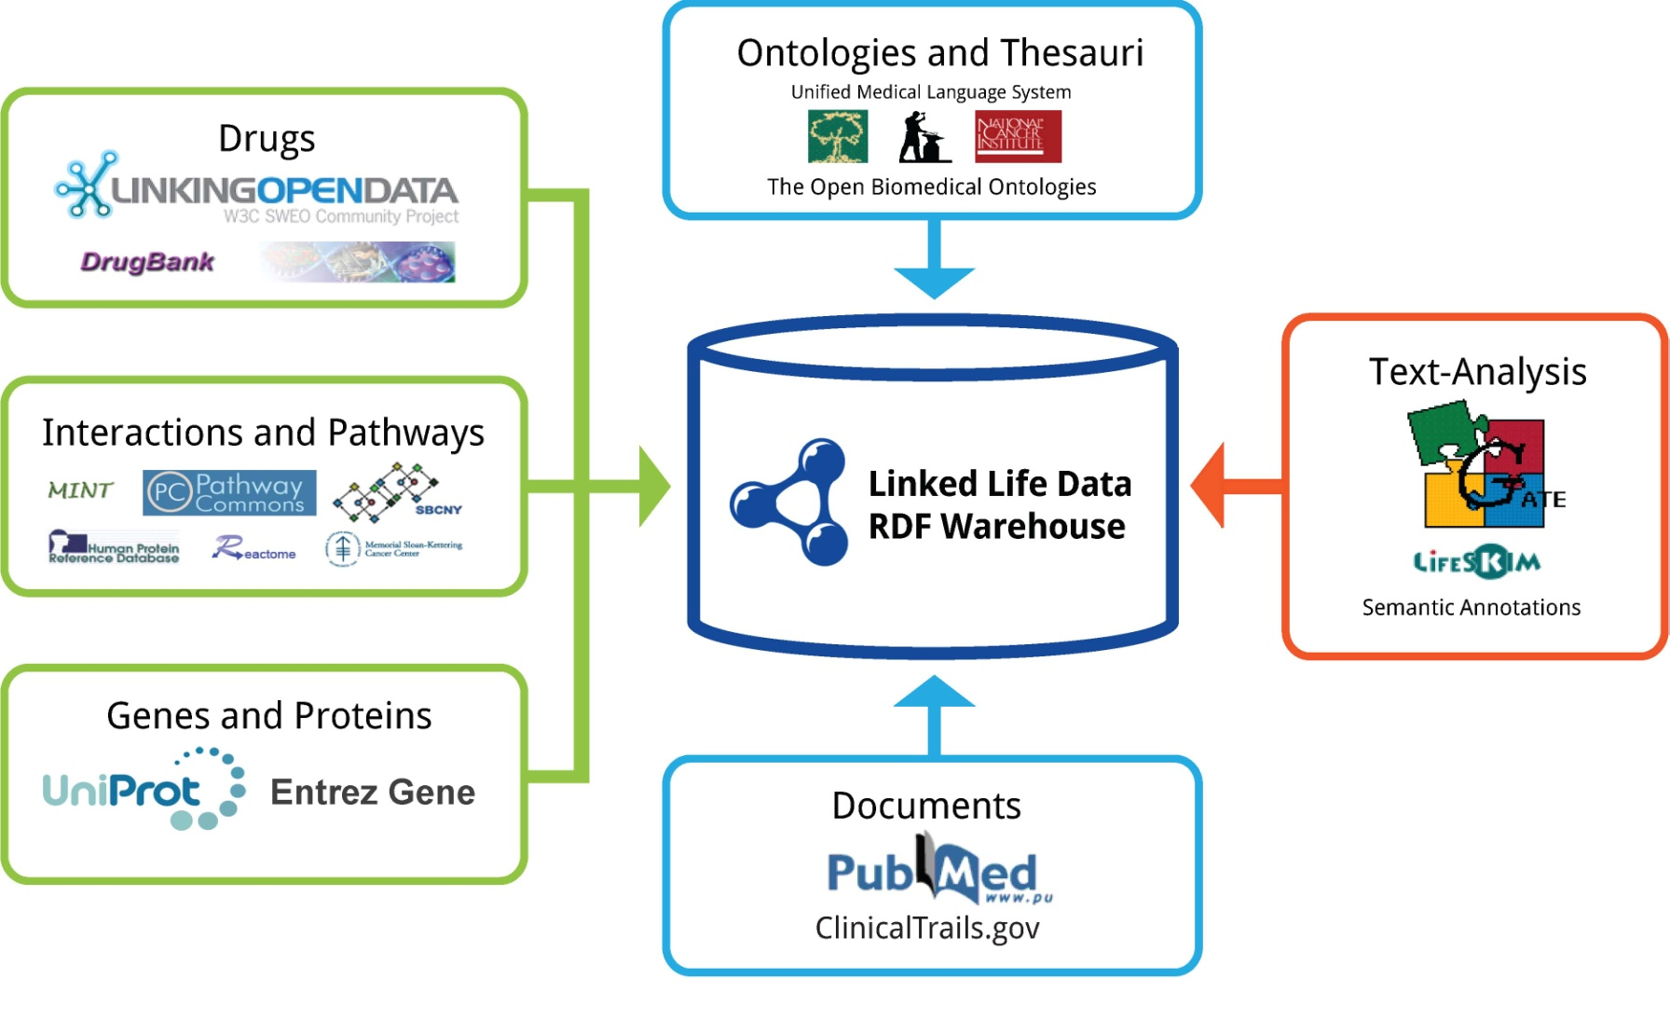
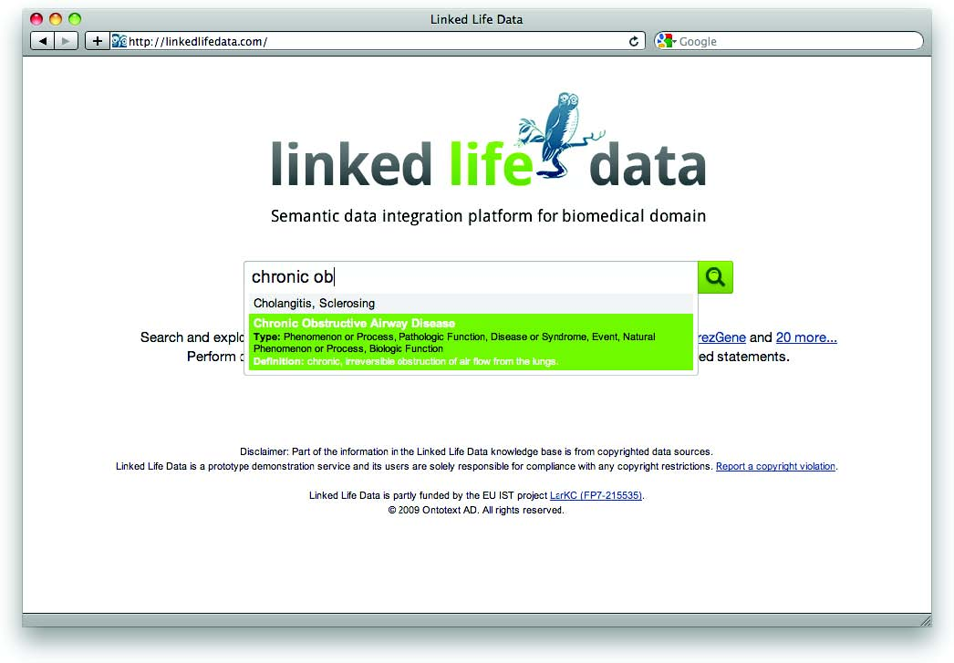
Linked Life Data Overview
Linked Life Data is a public and free RDF warehouse service
Offers a SPARQL endpoint
Integrates more than 25 popular biomedical data sources
Specifies many cross data sources semantic mappings
Exposes massive amounts of linked data
Notes:
LLD is a massive RDF warehouse that semantically integrates more than 25 biomedical data sources covering the full information path from:
genes, proteins, molecular interactions, targets, drugs, disease patient. (green boxes of the upper-right diagram)
This knowledge base is combined with thesauri and textual information (blue boxes) from UMLS, OBO foundry, Pubmed and ClinicalTrials.gov

Slide 3
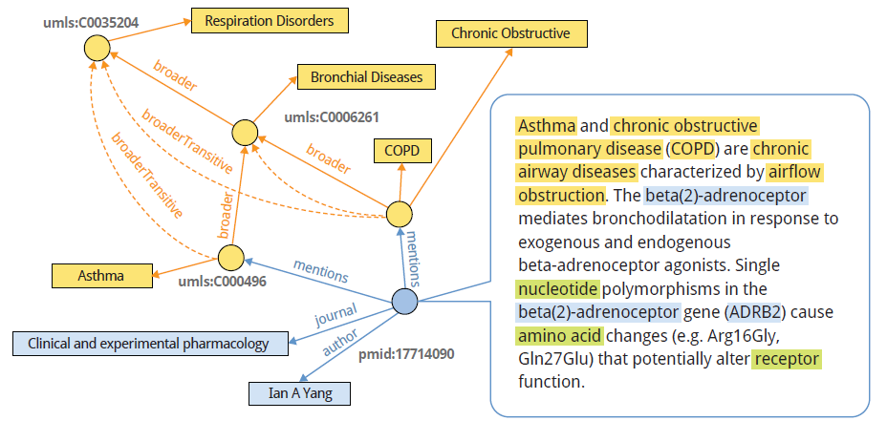
Semantic Annotations with LLD
Notes:
LLD is excellent tool for creating semantic annotations. Semantic annotations are textual annotation that points to an ontology identifier (URI).

Slide 4
Simple Knowledge Organisation Schema (SKOS)
SKOS is a data model
Serialized as RDF graph
Published on the web in a to be shared between applications
Efficient structuring of terms in thesauri
Allows the identification of the concepts by URLs
prefLabel
Respiratory Disease
broader
Bronchial Asthma
broader
altLabel
broader
prefLabel
prefLabel
Asthma
Chronic Obstructive Asthma
Notes:
SKOS is a data model that allows the simple organisation of the thesauri. It gives you a standard way to express broader/narrower concept, their synonyms, but also to publish it on the web.
(Describe the diagram – the graph structure on the right represent an example that describes Asthma, all specialization/generalizations of the disease)

Slide 5
SKOS Semantics to Map Across Different Thesauri
Relationship | Semantics | Example
Exact match | Transitive equivalence
Close match | Equivalent only for search purposes
Broader match | Generalization of a concept
Narrower match | Specialization of a concept | Inverse of broader match
Related | Unspecified relation (no real semantics)
Notes:
SKOS gives excellent capabilities for aligning multiple concept hierarchies

Slide 6
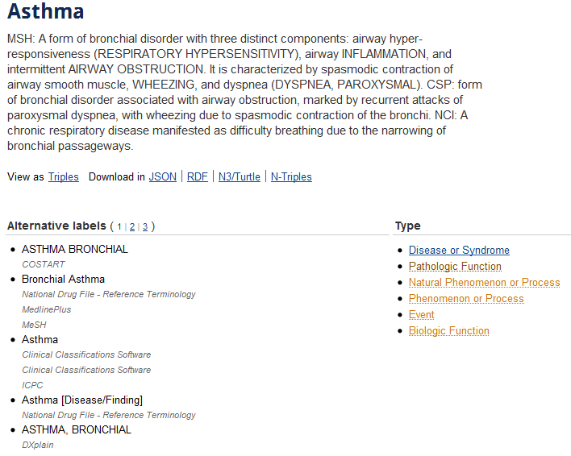
http://linkedlifedata.com/resource/umls/id/C0004096
Notes:
This is the view of the Asthma concept in a web browsed. The page is offered by LLD service.

Slide 7
http://linkedlifedata.com/resource/umls/id/C0004096
Different formats
Concept definition
Concept types
Concept labels
Notes:
You can see a more practical way to see SKOS schema. All data is coming from more than 120 thesauri integrated using UMLS data source.
Definition window = a formal definition of the concept
Concept labels = alignment between all synonyms across the different thesauri
Concept types = classification of the concept in the UMLS semantic network
You can download the data in JSON, RDF, N3, NTriples

Slide 8
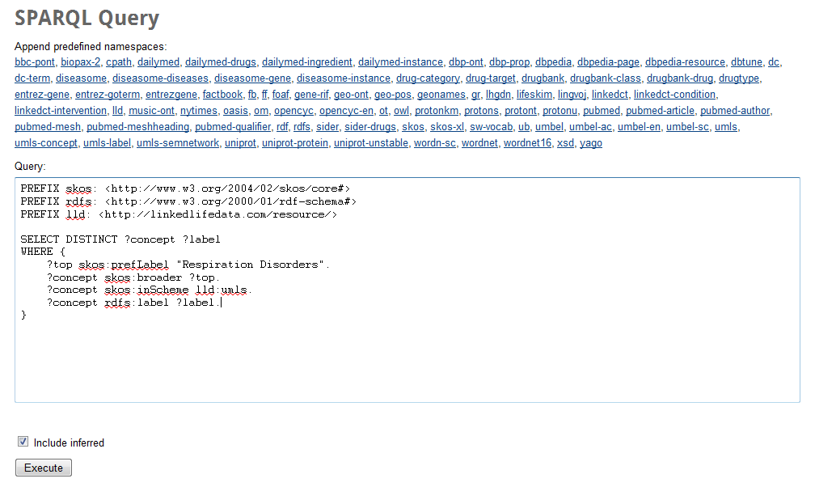
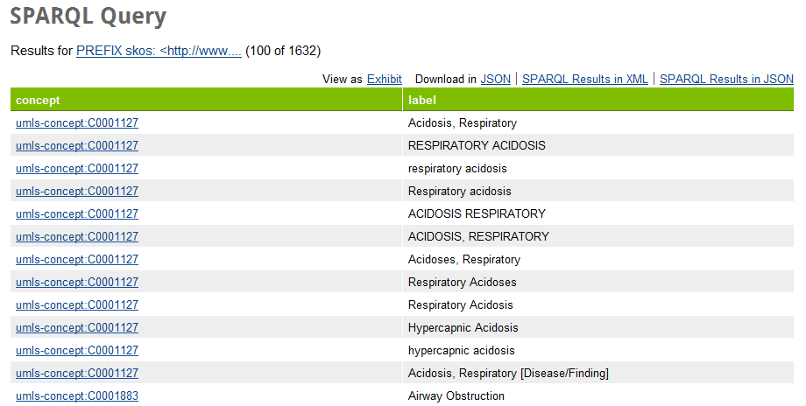
Querying LLD web interface with SPARQL
LLD supports a database like web interface for executing SPARQL queries, where:
You can test you query
Populate directly from the database your gazetteer (e.g. LKB Gazetteer)
Notes:
The data in LLD and described by the SKOS schema is an excellent tool for getting specific sets of concepts and populating gazetteer lists.

Slide 9
Querying SKOS Data
PREFIX skos: <http://www.w3.org/2004/02/skos/core#>
PREFIX rdfs: <http://www.w3.org/2000/01/rdf-schema#>
PREFIX lld: <http://linkedlifedata.com/resource/>
SELECT DISTINCT ?label ?concept ?top
WHERE {
?top skos:prefLabel "Respiration Disorders".
?concept skos:broader ?top.
?concept skos:inScheme lld:umls.
?concept rdfs:label ?label.
}
Namespace prefixes
concept with this name
child concepts
part of UMLS
all their synonyms
Return all “Respiration Disorder” concepts in LLD and all their IDs and labels
Notes:
Here is an example query that you can use with LKB gazetteer to get all respiration disorders. Just choose any concepts from the LLD repository and replace it’s prefLabel (title) with “Respiration Disorders”

Slide 10

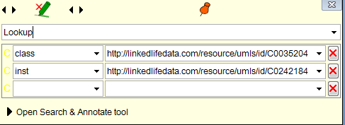
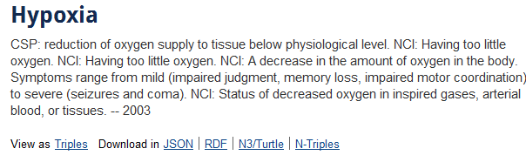
How to use LLD from Gate Developer?
Use LKB Gazetteer part of Gate Developer’s distribution
Modify “query.txt” file with the results you have tested
Point the gazetteer to the “repositoryURL” of:
http://linkedlifedata.com/sparql
Notes:
Simple guide how to do it. It is important to point back that all annotations have class and inst annotations

Slide 11
Conclusion

